Slide 1
SOA Exam FM
Module 3 – Section 6 (Part 2)
Bond Bought at Discount Example

Slide 2
Example
You buy a 4-year 1000 face value bond, redeemable at par, with 3% annual coupons. Determine the price of the bond to yield 6% annual effective.

Slide 3







Example
You buy a 4-year 1000 face value bond, redeemable at par, with 3% annual coupons. Determine the price of the bond to yield 6% annual effective.
$$1000$$
$$30$$
$$30$$
$$30$$
$$30$$
$$1$$
$$2$$
$$3$$
$$4$$
$$P$$

Slide 4

Example
You buy a 4-year 1000 face value bond, redeemable at par, with 3% annual coupons. Determine the price of the bond to yield 6% annual effective.
$$1000$$
$$30$$
$$30$$
$$30$$
$$30$$
$$1$$
$$2$$
$$3$$
$$4$$
$$P$$
$$=30a_{\overline{4}|0.06}+1000v_{0.06}^{4}$$

Slide 5

Example
You buy a 4-year 1000 face value bond, redeemable at par, with 3% annual coupons. Determine the price of the bond to yield 6% annual effective.
$$1000$$
$$30$$
$$30$$
$$30$$
$$30$$
$$1$$
$$2$$
$$3$$
$$4$$
$$P$$
$$=30a_{\overline{4}|0.06}+1000v_{0.06}^{4}$$
$$=896.05$$

Slide 6
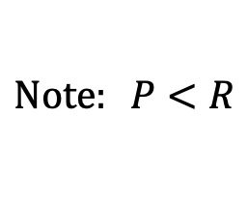
Example
You buy a 4-year 1000 face value bond, redeemable at par, with 3% annual coupons. Determine the price of the bond to yield 6% annual effective.
$$1000$$
$$30$$
$$30$$
$$30$$
$$30$$
$$1$$
$$2$$
$$3$$
$$4$$
$$P$$
$$=30a_{\overline{4}|0.06}+1000v_{0.06}^{4}$$
$$=896.05$$
$$Note: P<R$$

Slide 7
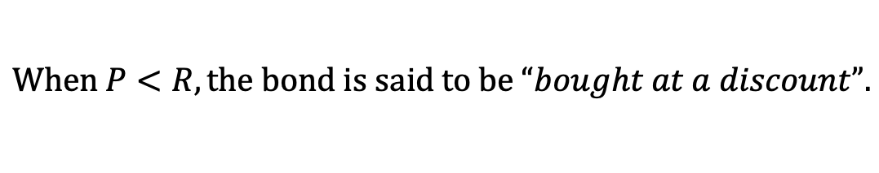
Example
You buy a 4-year 1000 face value bond, redeemable at par, with 3% annual coupons. Determine the price of the bond to yield 6% annual effective.
$$1000$$
$$30$$
$$30$$
$$30$$
$$30$$
$$1$$
$$2$$
$$3$$
$$4$$
$$P$$
$$=30a_{\overline{4}|0.06}+1000v_{0.06}^{4}$$
$$=896.05$$
$$Note: P<R$$
$$When P<R, the bond is said to be “bought at a discount”.$$

Slide 8
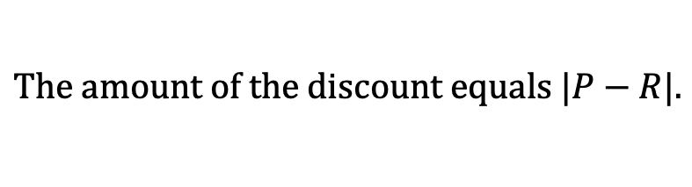
Example
You buy a 4-year 1000 face value bond, redeemable at par, with 3% annual coupons. Determine the price of the bond to yield 6% annual effective.
$$1000$$
$$30$$
$$30$$
$$30$$
$$30$$
$$1$$
$$2$$
$$3$$
$$4$$
$$P$$
$$=30a_{\overline{4}|0.06}+1000v_{0.06}^{4}$$
$$=896.05$$
$$Note: P<R$$
$$When P<R, the bond is said to be “bought at a discount”.$$
$$The amount of the discount equals |P−R|.$$

Slide 9
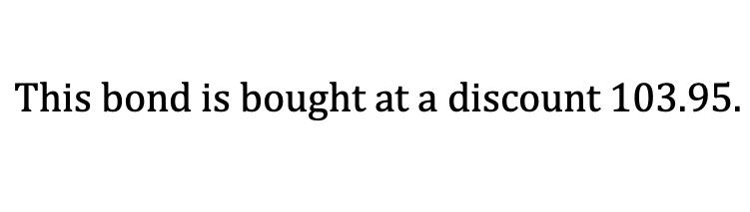
Example
You buy a 4-year 1000 face value bond, redeemable at par, with 3% annual coupons. Determine the price of the bond to yield 6% annual effective.
$$1000$$
$$30$$
$$30$$
$$30$$
$$30$$
$$1$$
$$2$$
$$3$$
$$4$$
$$P$$
$$=30a_{\overline{4}|0.06}+1000v_{0.06}^{4}$$
$$=896.05$$
$$This bond is bought at a discount 103.95.$$

Slide 10


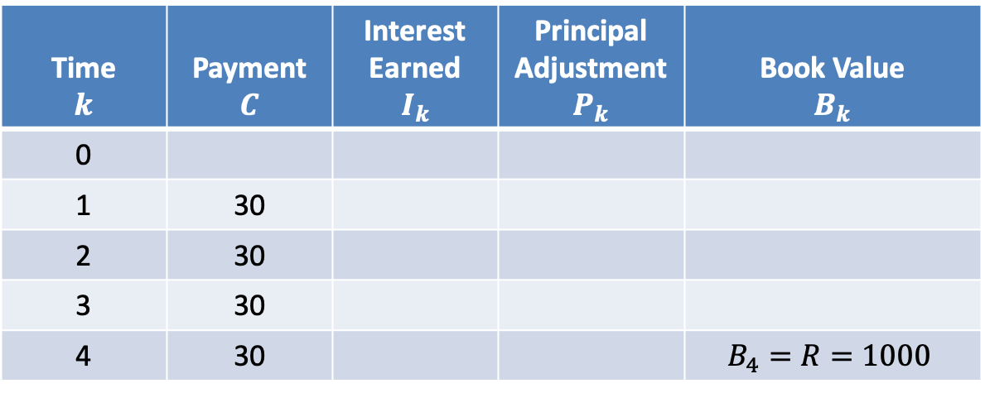
$$Amortization Table$$
$$i=0.06$$
Time $$k$$ | Payment $$C$$ | Interest Earned $$I_{k}$$ | Principal Adjustment $$P_{k}$$ | Book Value $$B_{k}$$
0
1 | 30
2 | 30
3 | 30
4 | 30 |  |  | $$B_{4}=R=1000$$

Slide 11
$$Amortization Table$$
$$i=0.06$$
Time $$k$$ | Payment $$C$$ | Interest Earned $$I_{k}$$ | Principal Adjustment $$P_{k}$$ | Book Value $$B_{k}$$
0
1 | 30
2 | 30
3 | 30
4 | 30 |  |  | $$B_{4}=R=1000$$
$$P$$
$$=30a_{\overline{4}|0.06}+1000v_{0.06}^{4}$$
$$=896.05$$

Slide 12
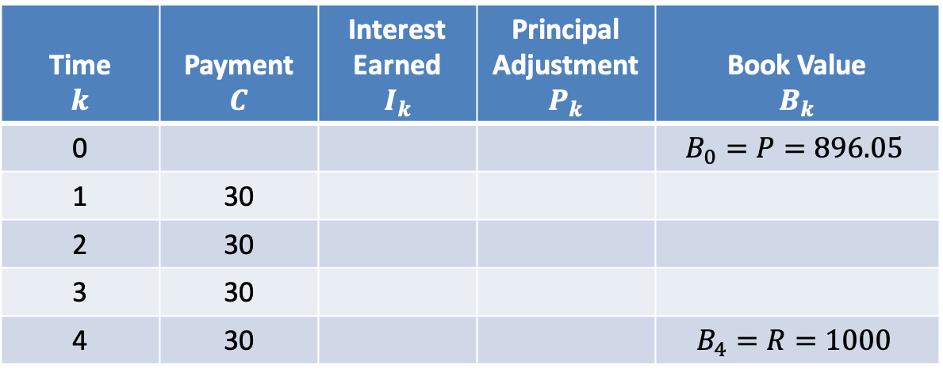
$$Amortization Table$$
$$i=0.06$$
Time $$k$$ | Payment $$C$$ | Interest Earned $$I_{k}$$ | Principal Adjustment $$P_{k}$$ | Book Value $$B_{k}$$
0 |  |  |  | $$B_{0}=P=896.05$$
1 | 30
2 | 30
3 | 30
4 | 30 |  |  | $$B_{4}=R=1000$$

Slide 13

$$Amortization Table$$
$$i=0.06$$
Time $$k$$ | Payment $$C$$ | Interest Earned $$I_{k}$$ | Principal Adjustment $$P_{k}$$ | Book Value $$B_{k}$$
0 |  |  |  | $$B_{0}=P=896.05$$
1 | 30
2 | 30
3 | 30
4 | 30 |  |  | $$B_{4}=R=1000$$
$$I_{1}=0.06∙896.05=53.76$$

Slide 14
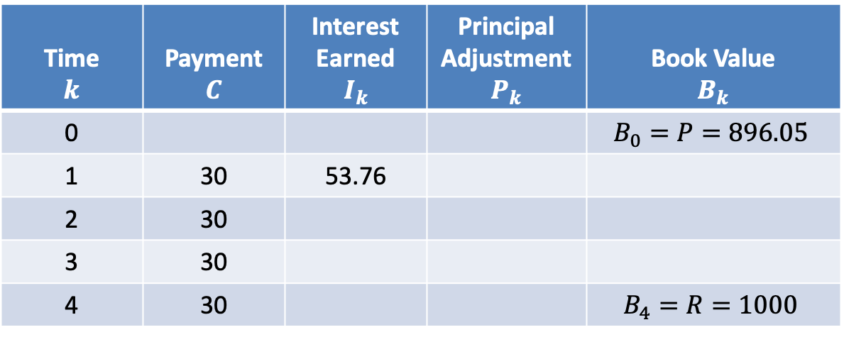
$$Amortization Table$$
$$i=0.06$$
Time $$k$$ | Payment $$C$$ | Interest Earned $$I_{k}$$ | Principal Adjustment $$P_{k}$$ | Book Value $$B_{k}$$
0 |  |  |  | $$B_{0}=P=896.05$$
1 | 30 | 53.76
2 | 30
3 | 30
4 | 30 |  |  | $$B_{4}=R=1000$$
$$I_{1}=0.06∙896.05=53.76$$

Slide 15

$$Amortization Table$$
$$i=0.06$$
Time $$k$$ | Payment $$C$$ | Interest Earned $$I_{k}$$ | Principal Adjustment $$P_{k}$$ | Book Value $$B_{k}$$
0 |  |  |  | $$B_{0}=P=896.05$$
1 | 30 | 53.76
2 | 30
3 | 30
4 | 30 |  |  | $$B_{4}=R=1000$$
$$I_{1}=0.06∙896.05=53.76$$
$$P_{1}=30−53.76=−23.76$$

Slide 16
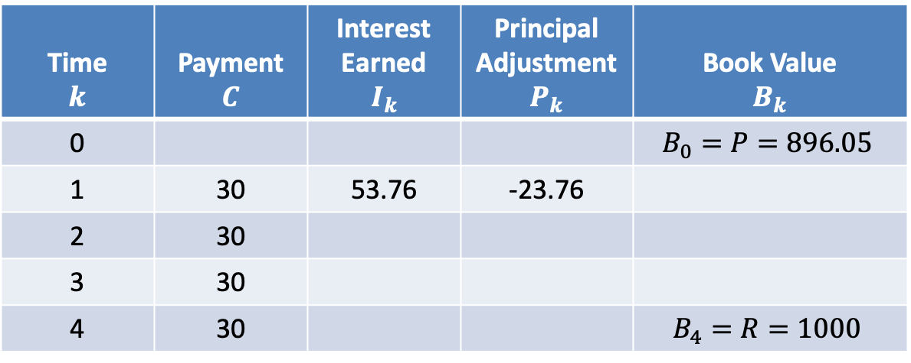
$$Amortization Table$$
$$i=0.06$$
Time $$k$$ | Payment $$C$$ | Interest Earned $$I_{k}$$ | Principal Adjustment $$P_{k}$$ | Book Value $$B_{k}$$
0 |  |  |  | $$B_{0}=P=896.05$$
1 | 30 | 53.76 | -23.76
2 | 30
3 | 30
4 | 30 |  |  | $$B_{4}=R=1000$$
$$I_{1}=0.06∙896.05=53.76$$
$$P_{1}=30−53.76=−23.76$$

Slide 17

$$Amortization Table$$
$$i=0.06$$
Time $$k$$ | Payment $$C$$ | Interest Earned $$I_{k}$$ | Principal Adjustment $$P_{k}$$ | Book Value $$B_{k}$$
0 |  |  |  | $$B_{0}=P=896.05$$
1 | 30 | 53.76 | -23.76
2 | 30
3 | 30
4 | 30 |  |  | $$B_{4}=R=1000$$
$$I_{1}=0.06∙896.05=53.76$$
$$P_{1}=30−53.76=−23.76$$
$$B_{1}=896.05−(−23.76)=919.81$$

Slide 18
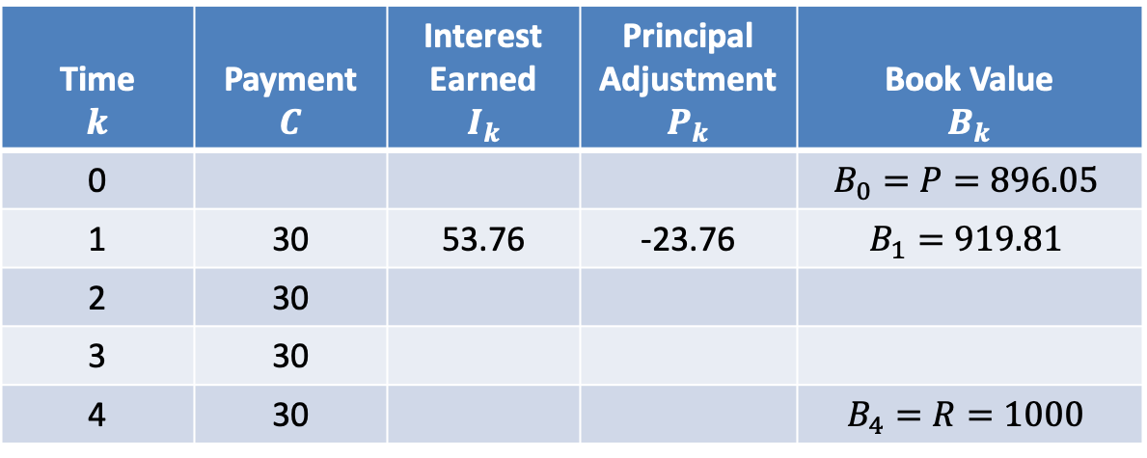
$$Amortization Table$$
$$i=0.06$$
Time $$k$$ | Payment $$C$$ | Interest Earned $$I_{k}$$ | Principal Adjustment $$P_{k}$$ | Book Value $$B_{k}$$
0 |  |  |  | $$B_{0}=P=896.05$$
1 | 30 | 53.76 | -23.76 | $$B_{1}=919.81$$
2 | 30
3 | 30
4 | 30 |  |  | $$B_{4}=R=1000$$
$$I_{1}=0.06∙896.05=53.76$$
$$P_{1}=30−53.76=−23.76$$
$$B_{1}=896.05−(−23.76)=919.81$$

Slide 19

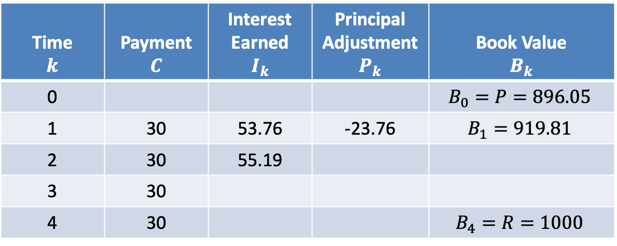
$$Amortization Table$$
$$i=0.06$$
Time $$k$$ | Payment $$C$$ | Interest Earned $$I_{k}$$ | Principal Adjustment $$P_{k}$$ | Book Value $$B_{k}$$
0 |  |  |  | $$B_{0}=P=896.05$$
1 | 30 | 53.76 | -23.76 | $$B_{1}=919.81$$
2 | 30 | 55.19
3 | 30
4 | 30 |  |  | $$B_{4}=R=1000$$
$$I_{2}=0.06∙919.81=55.19$$

Slide 20

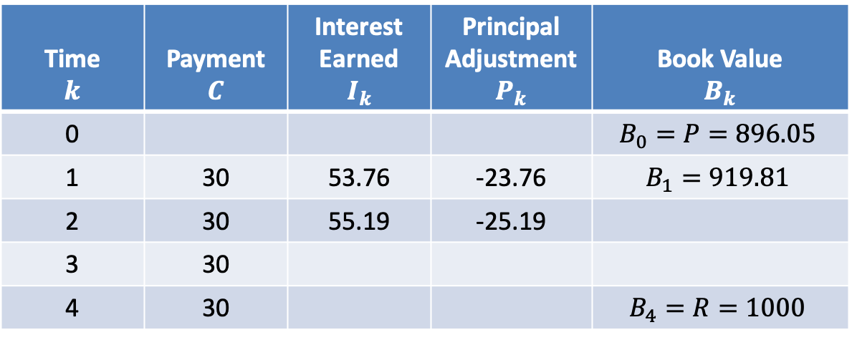
$$Amortization Table$$
$$i=0.06$$
Time $$k$$ | Payment $$C$$ | Interest Earned $$I_{k}$$ | Principal Adjustment $$P_{k}$$ | Book Value $$B_{k}$$
0 |  |  |  | $$B_{0}=P=896.05$$
1 | 30 | 53.76 | -23.76 | $$B_{1}=919.81$$
2 | 30 | 55.19 | -25.19
3 | 30
4 | 30 |  |  | $$B_{4}=R=1000$$
$$I_{2}=0.06∙919.81=55.19$$
$$P_{2}=30−55.19=−25.19$$

Slide 21

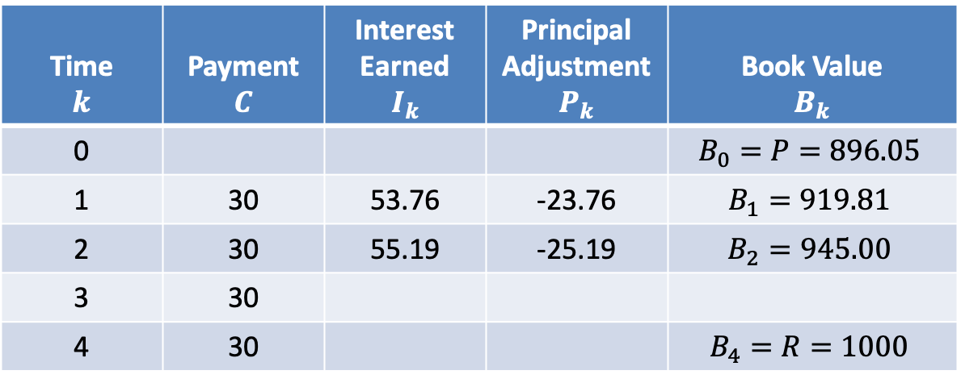
$$Amortization Table$$
$$i=0.06$$
Time $$k$$ | Payment $$C$$ | Interest Earned $$I_{k}$$ | Principal Adjustment $$P_{k}$$ | Book Value $$B_{k}$$
0 |  |  |  | $$B_{0}=P=896.05$$
1 | 30 | 53.76 | -23.76 | $$B_{1}=919.81$$
2 | 30 | 55.19 | -25.19 | $$B_{2}=945.00$$
3 | 30
4 | 30 |  |  | $$B_{4}=R=1000$$
$$I_{2}=0.06∙919.81=55.19$$
$$P_{2}=30−55.19=−25.19$$
$$B_{2}=919.81−(−25.19)=945.00$$

Slide 22

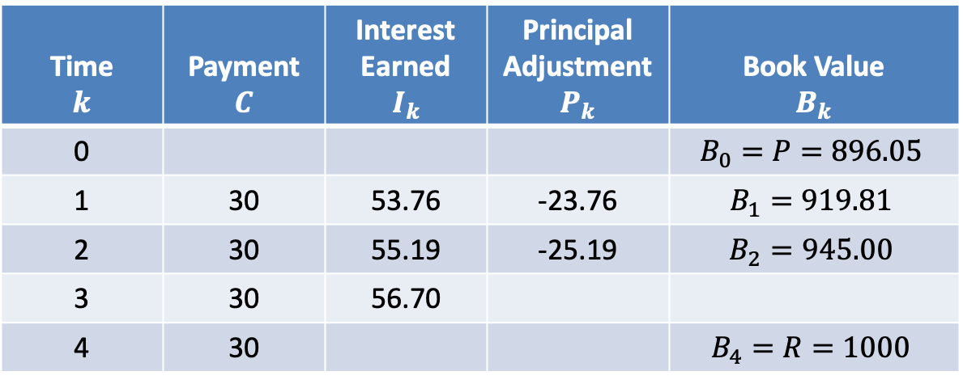
$$Amortization Table$$
$$i=0.06$$
Time $$k$$ | Payment $$C$$ | Interest Earned $$I_{k}$$ | Principal Adjustment $$P_{k}$$ | Book Value $$B_{k}$$
0 |  |  |  | $$B_{0}=P=896.05$$
1 | 30 | 53.76 | -23.76 | $$B_{1}=919.81$$
2 | 30 | 55.19 | -25.19 | $$B_{2}=945.00$$
3 | 30 | 56.70
4 | 30 |  |  | $$B_{4}=R=1000$$
$$I_{3}=0.06∙945.00=56.70$$

Slide 23

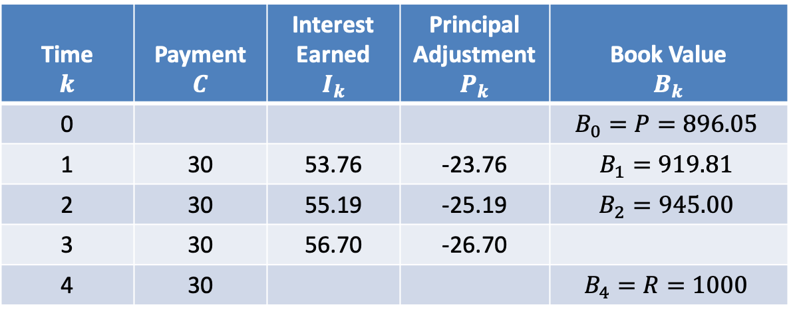
$$Amortization Table$$
$$i=0.06$$
Time $$k$$ | Payment $$C$$ | Interest Earned $$I_{k}$$ | Principal Adjustment $$P_{k}$$ | Book Value $$B_{k}$$
0 |  |  |  | $$B_{0}=P=896.05$$
1 | 30 | 53.76 | -23.76 | $$B_{1}=919.81$$
2 | 30 | 55.19 | -25.19 | $$B_{2}=945.00$$
3 | 30 | 56.70 | -26.70
4 | 30 |  |  | $$B_{4}=R=1000$$
$$I_{3}=0.06∙945.00=56.70$$
$$P_{3}=30−56.70=−26.70$$

Slide 24

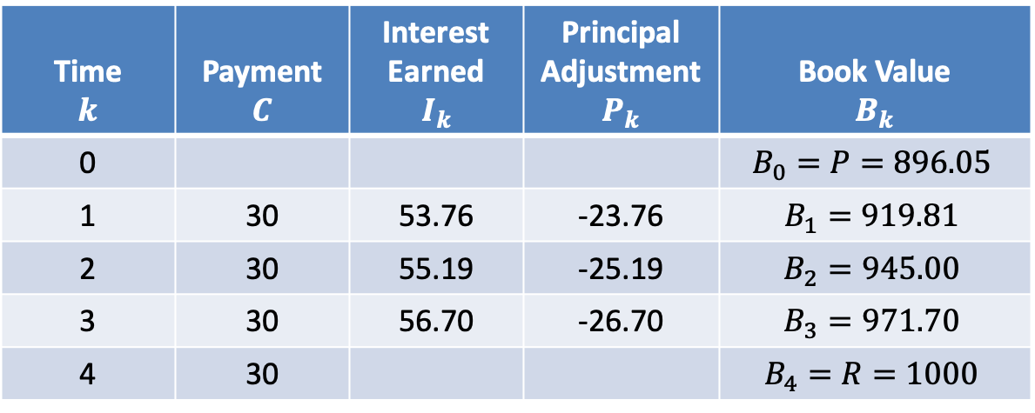
$$Amortization Table$$
$$i=0.06$$
Time $$k$$ | Payment $$C$$ | Interest Earned $$I_{k}$$ | Principal Adjustment $$P_{k}$$ | Book Value $$B_{k}$$
0 |  |  |  | $$B_{0}=P=896.05$$
1 | 30 | 53.76 | -23.76 | $$B_{1}=919.81$$
2 | 30 | 55.19 | -25.19 | $$B_{2}=945.00$$
3 | 30 | 56.70 | -26.70 | $$B_{3}=971.70$$
4 | 30 |  |  | $$B_{4}=R=1000$$
$$I_{3}=0.06∙945.00=56.70$$
$$P_{3}=30−56.70=−26.70$$
$$B_{3}=945.00−(−26.70)=971.70$$

Slide 25

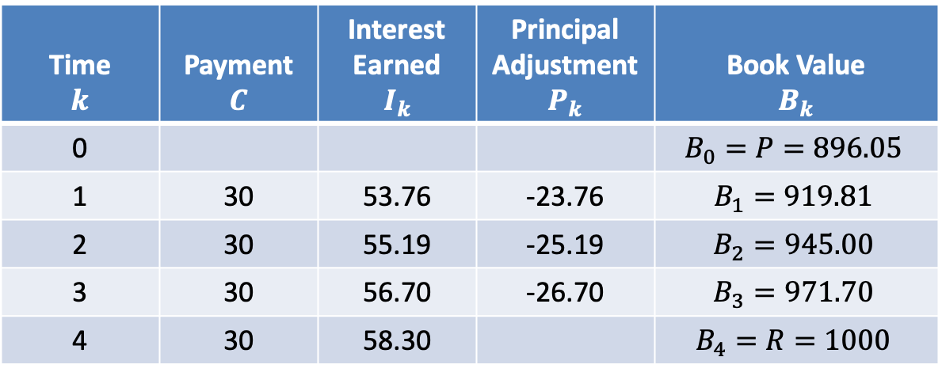
$$Amortization Table$$
$$i=0.06$$
Time $$k$$ | Payment $$C$$ | Interest Earned $$I_{k}$$ | Principal Adjustment $$P_{k}$$ | Book Value $$B_{k}$$
0 |  |  |  | $$B_{0}=P=896.05$$
1 | 30 | 53.76 | -23.76 | $$B_{1}=919.81$$
2 | 30 | 55.19 | -25.19 | $$B_{2}=945.00$$
3 | 30 | 56.70 | -26.70 | $$B_{3}=971.70$$
4 | 30 | 58.30 |  | $$B_{4}=R=1000$$
$$I_{4}=0.06∙971.70=58.30$$

Slide 26


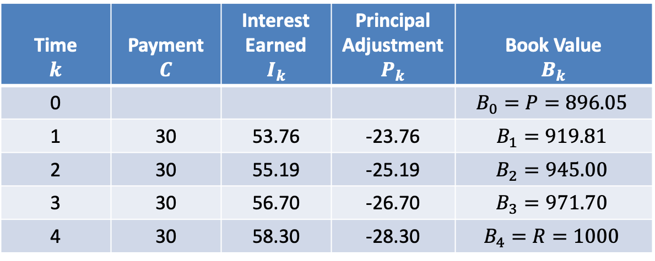
$$Amortization Table$$
$$i=0.06$$
Time $$k$$ | Payment $$C$$ | Interest Earned $$I_{k}$$ | Principal Adjustment $$P_{k}$$ | Book Value $$B_{k}$$
0 |  |  |  | $$B_{0}=P=896.05$$
1 | 30 | 53.76 | -23.76 | $$B_{1}=919.81$$
2 | 30 | 55.19 | -25.19 | $$B_{2}=945.00$$
3 | 30 | 56.70 | -26.70 | $$B_{3}=971.70$$
4 | 30 | 58.30 | -28.30 | $$B_{4}=R=1000$$
$$I_{4}=0.06∙971.70=58.30$$
$$P_{4}=30−58.30=−28.30$$
$$B_{4}=971.70−(−28.30)=1000$$

Slide 27
$$Amortization Table$$
$$i=0.06$$
Time $$k$$ | Payment $$C$$ | Interest Earned $$I_{k}$$ | Principal Adjustment $$P_{k}$$ | Book Value $$B_{k}$$
0 |  |  |  | $$B_{0}=P=896.05$$
1 | 30 | 53.76 | -23.76 | $$B_{1}=919.81$$
2 | 30 | 55.19 | -25.19 | $$B_{2}=945.00$$
3 | 30 | 56.70 | -26.70 | $$B_{3}=971.70$$
4 | 30 | 58.30 | -28.30 | $$B_{4}=R=1000$$

Slide 28

$$Amortization Table$$
$$i=0.06$$
Time $$k$$ | Payment $$C$$ | Interest Earned $$I_{k}$$ | Principal Adjustment $$P_{k}$$ | Book Value $$B_{k}$$
0 |  |  |  | $$B_{0}=P=896.05$$
1 | 30 | 53.76 | -23.76 | $$B_{1}=919.81$$
2 | 30 | 55.19 | -25.19 | $$B_{2}=945.00$$
3 | 30 | 56.70 | -26.70 | $$B_{3}=971.70$$
4 | 30 | 58.30 | -28.30 | $$B_{4}=R=1000$$
$$Σ=−103.95$$

Slide 29

$$Amortization Table$$
$$i=0.06$$
Time $$k$$ | Payment $$C$$ | Interest Earned $$I_{k}$$ | Principal Adjustment $$P_{k}$$ | Book Value $$B_{k}$$
0 |  |  |  | $$B_{0}=P=896.05$$
1 | 30 | 53.76 | -23.76 | $$B_{1}=919.81$$
2 | 30 | 55.19 | -25.19 | $$B_{2}=945.00$$
3 | 30 | 56.70 | -26.70 | $$B_{3}=971.70$$
4 | 30 | 58.30 | -28.30 | $$B_{4}=R=1000$$
$$Σ=−103.95$$
$$=B_{0}−B_{n}$$

Slide 30
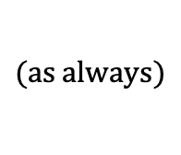
$$Amortization Table$$
$$i=0.06$$
Time $$k$$ | Payment $$C$$ | Interest Earned $$I_{k}$$ | Principal Adjustment $$P_{k}$$ | Book Value $$B_{k}$$
0 |  |  |  | $$B_{0}=P=896.05$$
1 | 30 | 53.76 | -23.76 | $$B_{1}=919.81$$
2 | 30 | 55.19 | -25.19 | $$B_{2}=945.00$$
3 | 30 | 56.70 | -26.70 | $$B_{3}=971.70$$
4 | 30 | 58.30 | -28.30 | $$B_{4}=R=1000$$
$$Σ=−103.95$$
$$=B_{0}−B_{n}$$
$$(as always)$$

Slide 31
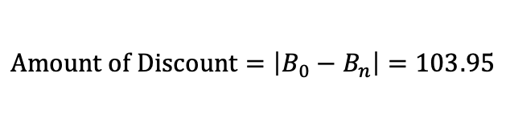
$$Amortization Table$$
$$i=0.06$$
Time $$k$$ | Payment $$C$$ | Interest Earned $$I_{k}$$ | Principal Adjustment $$P_{k}$$ | Book Value $$B_{k}$$
0 |  |  |  | $$B_{0}=P=896.05$$
1 | 30 | 53.76 | -23.76 | $$B_{1}=919.81$$
2 | 30 | 55.19 | -25.19 | $$B_{2}=945.00$$
3 | 30 | 56.70 | -26.70 | $$B_{3}=971.70$$
4 | 30 | 58.30 | -28.30 | $$B_{4}=R=1000$$
$$Σ=−103.95$$
$$=B_{0}−B_{n}$$
$$(as always)$$
$$Amount of Discount=\left|B_{0}−B_{n}\right|=103.95$$

Slide 32
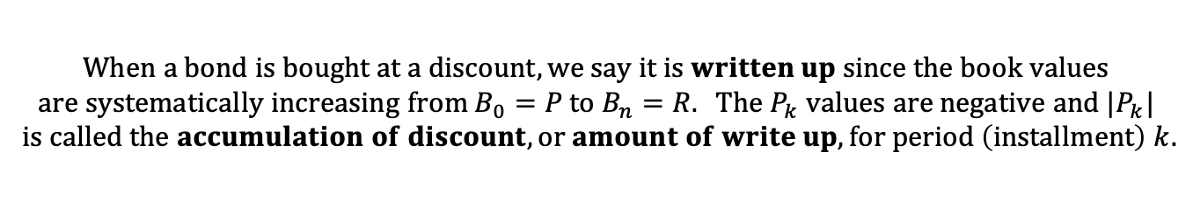
$$Amortization Table$$
$$i=0.06$$
Time $$k$$ | Payment $$C$$ | Interest Earned $$I_{k}$$ | Principal Adjustment $$P_{k}$$ | Book Value $$B_{k}$$
0 |  |  |  | $$B_{0}=P=896.05$$
1 | 30 | 53.76 | -23.76 | $$B_{1}=919.81$$
2 | 30 | 55.19 | -25.19 | $$B_{2}=945.00$$
3 | 30 | 56.70 | -26.70 | $$B_{3}=971.70$$
4 | 30 | 58.30 | -28.30 | $$B_{4}=R=1000$$
$$Σ=−103.95$$
$$=B_{0}−B_{n}$$
$$(as always)$$
$$Amount of Discount=\left|B_{0}−B_{n}\right|=103.95$$
$$When a bond is bought at a discount, we say it is written up since the book values \\ are systematically increasing from B_{0}=P to B_{n}=R. The P_{k} values are negative and |P_{k}|$$
$$is called the accumulation of discount, or amount of write up, for period \left(installment\right) k.$$

Slide 33
$$Amortization Table$$
$$i=0.06$$
Time $$k$$ | Payment $$C$$ | Interest Earned $$I_{k}$$ | Principal Adjustment $$P_{k}$$ | Book Value $$B_{k}$$
0 |  |  |  | $$B_{0}=P=896.05$$
1 | 30 | 53.76 | -23.76 | $$B_{1}=919.81$$
2 | 30 | 55.19 | -25.19 | $$B_{2}=945.00$$
3 | 30 | 56.70 | -26.70 | $$B_{3}=971.70$$
4 | 30 | 58.30 | -28.30 | $$B_{4}=R=1000$$

Slide 34

$$Amortization Table$$
$$i=0.06$$
Time $$k$$ | Payment $$C$$ | Interest Earned $$I_{k}$$ | Principal Adjustment $$P_{k}$$ | Book Value $$B_{k}$$
0 |  |  |  | $$B_{0}=P=896.05$$
1 | 30 | 53.76 | -23.76 | $$B_{1}=919.81$$
2 | 30 | 55.19 | -25.19 | $$B_{2}=945.00$$
3 | 30 | 56.70 | -26.70 | $$B_{3}=971.70$$
4 | 30 | 58.30 | -28.30 | $$B_{4}=R=1000$$
$$\frac{−25.19}{−23.76}=1.06$$

Slide 35

$$Amortization Table$$
$$i=0.06$$
Time $$k$$ | Payment $$C$$ | Interest Earned $$I_{k}$$ | Principal Adjustment $$P_{k}$$ | Book Value $$B_{k}$$
0 |  |  |  | $$B_{0}=P=896.05$$
1 | 30 | 53.76 | -23.76 | $$B_{1}=919.81$$
2 | 30 | 55.19 | -25.19 | $$B_{2}=945.00$$
3 | 30 | 56.70 | -26.70 | $$B_{3}=971.70$$
4 | 30 | 58.30 | -28.30 | $$B_{4}=R=1000$$
$$\frac{−25.19}{−23.76}=1.06$$
$$\frac{−26.70}{−25.19}=1.06$$

Slide 36

$$Amortization Table$$
$$i=0.06$$
Time $$k$$ | Payment $$C$$ | Interest Earned $$I_{k}$$ | Principal Adjustment $$P_{k}$$ | Book Value $$B_{k}$$
0 |  |  |  | $$B_{0}=P=896.05$$
1 | 30 | 53.76 | -23.76 | $$B_{1}=919.81$$
2 | 30 | 55.19 | -25.19 | $$B_{2}=945.00$$
3 | 30 | 56.70 | -26.70 | $$B_{3}=971.70$$
4 | 30 | 58.30 | -28.30 | $$B_{4}=R=1000$$
$$\frac{−25.19}{−23.76}=1.06$$
$$\frac{−26.70}{−25.19}=1.06$$
$$\frac{−28.30}{−26.70}=1.06$$

Slide 37
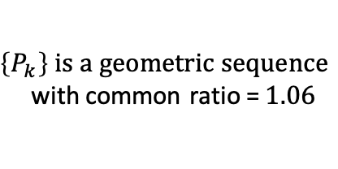
$$Amortization Table$$
$$i=0.06$$
Time $$k$$ | Payment $$C$$ | Interest Earned $$I_{k}$$ | Principal Adjustment $$P_{k}$$ | Book Value $$B_{k}$$
0 |  |  |  | $$B_{0}=P=896.05$$
1 | 30 | 53.76 | -23.76 | $$B_{1}=919.81$$
2 | 30 | 55.19 | -25.19 | $$B_{2}=945.00$$
3 | 30 | 56.70 | -26.70 | $$B_{3}=971.70$$
4 | 30 | 58.30 | -28.30 | $$B_{4}=R=1000$$
$$\frac{−25.19}{−23.76}=1.06$$
$$\frac{−26.70}{−25.19}=1.06$$
$\left\{P_{k}\right\} is a geometric sequence$
with common ratio =$1.06$
$$\frac{−28.30}{−26.70}=1.06$$

Slide 38
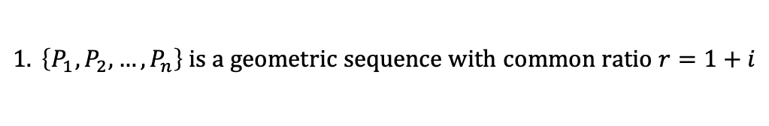

$$Amortization Table$$
$$i=0.06$$
Time $$k$$ | Payment $$C$$ | Interest Earned $$I_{k}$$ | Principal Adjustment $$P_{k}$$ | Book Value $$B_{k}$$
0 |  |  |  | $$B_{0}=P=896.05$$
1 | 30 | 53.76 | -23.76 | $$B_{1}=919.81$$
2 | 30 | 55.19 | -25.19 | $$B_{2}=945.00$$
3 | 30 | 56.70 | -26.70 | $$B_{3}=971.70$$
4 | 30 | 58.30 | -28.30 | $$B_{4}=R=1000$$
$$General Remarks:$$
$$1. \left\{P_{1},P_{2},…,P_{n}\right\} is a geometric sequence with common ratio r=1+i$$

Slide 39


$$Amortization Table$$
$$i=0.06$$
Time $$k$$ | Payment $$C$$ | Interest Earned $$I_{k}$$ | Principal Adjustment $$P_{k}$$ | Book Value $$B_{k}$$
0 |  |  |  | $$B_{0}=P=896.05$$
1 | 30 | 53.76 | -23.76 | $$B_{1}=919.81$$
2 | 30 | 55.19 | -25.19 | $$B_{2}=945.00$$
3 | 30 | 56.70 | -26.70 | $$B_{3}=971.70$$
4 | 30 | 58.30 | -28.30 | $$B_{4}=R=1000$$
$$General Remarks:$$
$$1. \left\{P_{1},P_{2},…,P_{n}\right\} is a geometric sequence with common ratio r=1+i$$
$$2. \sum{P_{k}}=P_{1}+P_{2}+…+P_{n}$$
$$=P_{1}+P_{1}(1+i)+…+P_{1}{(1+i)}^{n−1}$$

Slide 40
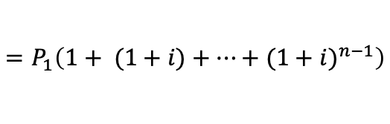
$$Amortization Table$$
$$i=0.06$$
Time $$k$$ | Payment $$C$$ | Interest Earned $$I_{k}$$ | Principal Adjustment $$P_{k}$$ | Book Value $$B_{k}$$
0 |  |  |  | $$B_{0}=P=896.05$$
1 | 30 | 53.76 | -23.76 | $$B_{1}=919.81$$
2 | 30 | 55.19 | -25.19 | $$B_{2}=945.00$$
3 | 30 | 56.70 | -26.70 | $$B_{3}=971.70$$
4 | 30 | 58.30 | -28.30 | $$B_{4}=R=1000$$
$$General Remarks:$$
$$1. \left\{P_{1},P_{2},…,P_{n}\right\} is a geometric sequence with common ratio r=1+i$$
$$2. \sum{P_{k}}=P_{1}+P_{2}+…+P_{n}$$
$$=P_{1}\left(1+ (1+i)+…+{(1+i)}^{n−1}\right)$$

Slide 41

$$Amortization Table$$
$$i=0.06$$
Time $$k$$ | Payment $$C$$ | Interest Earned $$I_{k}$$ | Principal Adjustment $$P_{k}$$ | Book Value $$B_{k}$$
0 |  |  |  | $$B_{0}=P=896.05$$
1 | 30 | 53.76 | -23.76 | $$B_{1}=919.81$$
2 | 30 | 55.19 | -25.19 | $$B_{2}=945.00$$
3 | 30 | 56.70 | -26.70 | $$B_{3}=971.70$$
4 | 30 | 58.30 | -28.30 | $$B_{4}=R=1000$$
$$General Remarks:$$
$$1. \left\{P_{1},P_{2},…,P_{n}\right\} is a geometric sequence with common ratio r=1+i$$
$$2. \sum{P_{k}}=P_{1}+P_{2}+…+P_{n}$$
$$=P_{1}\left(1+ (1+i)+…+{(1+i)}^{n−1}\right)$$
$$=P_{1}∙s_{\overline{n}|}$$

Slide 42

$$Amortization Table$$
$$i=0.06$$
Time $$k$$ | Payment $$C$$ | Interest Earned $$I_{k}$$ | Principal Adjustment $$P_{k}$$ | Book Value $$B_{k}$$
0 |  |  |  | $$B_{0}=P=896.05$$
1 | 30 | 53.76 | -23.76 | $$B_{1}=919.81$$
2 | 30 | 55.19 | -25.19 | $$B_{2}=945.00$$
3 | 30 | 56.70 | -26.70 | $$B_{3}=971.70$$
4 | 30 | 58.30 | -28.30 | $$B_{4}=R=1000$$
$$General Remarks:$$
$$1. \left\{P_{1},P_{2},…,P_{n}\right\} is a geometric sequence with common ratio r=1+i$$
$$2. \sum{P_{k}}=P_{1}+P_{2}+…+P_{n}$$
$$=P_{1}\left(1+ (1+i)+…+{(1+i)}^{n−1}\right)$$
$$=P_{1}∙s_{\overline{n}|}$$
$$=P−R$$

Slide 43
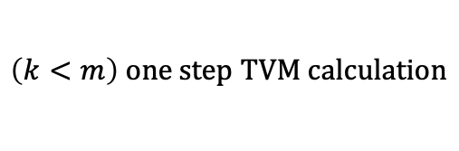
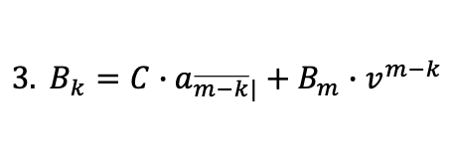
$$Amortization Table$$
$$i=0.06$$
Time $$k$$ | Payment $$C$$ | Interest Earned $$I_{k}$$ | Principal Adjustment $$P_{k}$$ | Book Value $$B_{k}$$
0 |  |  |  | $$B_{0}=P=896.05$$
1 | 30 | 53.76 | -23.76 | $$B_{1}=919.81$$
2 | 30 | 55.19 | -25.19 | $$B_{2}=945.00$$
3 | 30 | 56.70 | -26.70 | $$B_{3}=971.70$$
4 | 30 | 58.30 | -28.30 | $$B_{4}=R=1000$$
$$General Remarks:$$
$$1. \left\{P_{1},P_{2},…,P_{n}\right\} is a geometric sequence with common ratio r=1+i$$
$$2. \sum{P_{k}}=P_{1}+P_{2}+…+P_{n}$$
$$=P_{1}\left(1+ (1+i)+…+{(1+i)}^{n−1}\right)$$
$$=P_{1}∙s_{\overline{n}|}$$
$$=P−R$$
$$3. B_{k}=C∙a_{\overline{m−k}|}+B_{m}∙v^{m−k}$$
$$\left(k<m\right) one step TVM calculation$$

